Slide 1
erakorralise meditsiini tehniku roll kiirabis ja erakorralise meditsiini osakonnas ning nende tööülesannete sooritamiseks vajalikud teadmised ja oskused
Tallinn 2016

Slide 2
Emergency Medical Technician (EMT) and ambulance technician are terms used in some countries to denote a health care provider of emergency medical services.^{[1]}
EMTs are clinicians, trained to respond quickly to emergency situations regarding medical issues, traumatic injuries and accident scenes.
EMTs are often employed by private ambulance services, governments, and hospitals, but are also often employed by fire departments (and seen on fire apparatus), in police departments (and seen on police vehicles), and there are many firefighter/EMTs and police officer/EMTs.^{[1]}
EMTs operate under a limited scope of practice.
EMTs are normally supervised by a medical director, who is a physician.^{[3]}
Some EMTs are paid employees, while others (particularly those in rural areas) are volunteers.^{[1]}

Slide 3
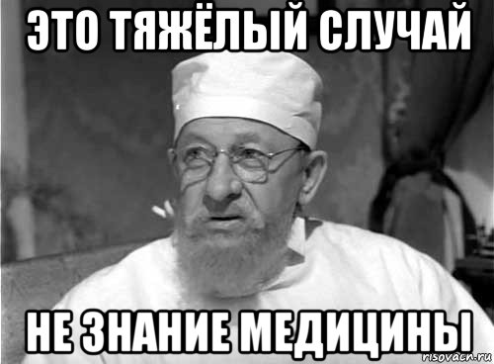
EMO tehniku teadmised
Anatoomia
Patofüsioloogia (põhilised patoloogilised protsessid)
Farmakoloogia alused
Ergonoomika
Deontoloogia
Aseptika
Desmurgia + immobilisatsioon
BLS + ACLS
ATLS "Initial Assessment and Management„ TEAM®

Slide 4
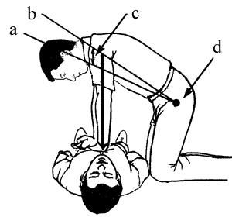
EMO tehniku oskused
Patient assessment, vitals and continuous monitoring and reassessment (BLS interventions when indicated) - A note on this, this is as much as you make it, RN's are typically not going to be reassessing their patients as much as you will have the opportunity to, simply because of their other job functions.
airway management (opa/npa, BVM, suctioning, ect..)
wound care (cleaning wounds, dressing wounds, splinting)
CPR during codes
Obtaining EKG's
Lobby triage
Stocking supplies
Transport (using your two legs!)
Usually you'll have an option to learn phlebotomy (no IV's though)
Obtain trays/special needs for RN, PA, NP or Doc
"Assist" with various procedures at the discretion of the RN PA, NP or Doc (foley/ng tube/sutures, chest tubes/central lines ect..)
Patsiendi seisundi hindamine, eluliste parameetrite jälgimine
Hingamisteede käsitlus – aspiratsioon, hapnik, CPAP maski asetamine jne
Haava töötlus, jäsemete immobilisatsioon, vaagna pehme fiksaatori asetamine
Rahutu patsiendi ohjeldamise tehnika ja võtted
Kardiopulmonaalse taaselustamise võtted (CPR)
EKG registreerimine
EMO triaažis assisteerimine
Transport (raam)
i/v liini rajamine
Assisteerimine protseduuridel (foley/ngsond/õmblus/pleuradreenaaž/tsentraalne veen jne)
Sanitaarkorrastus

Slide 5
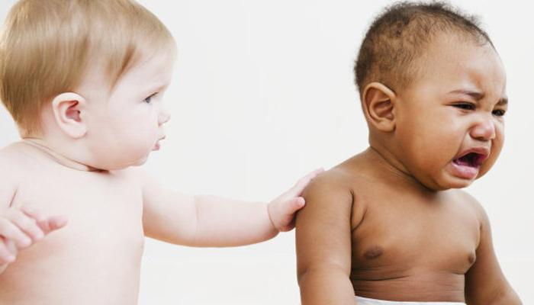
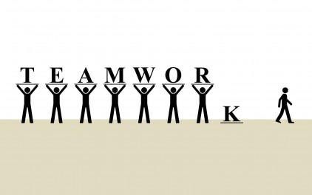
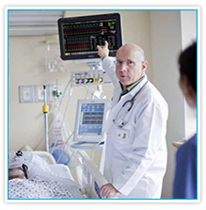
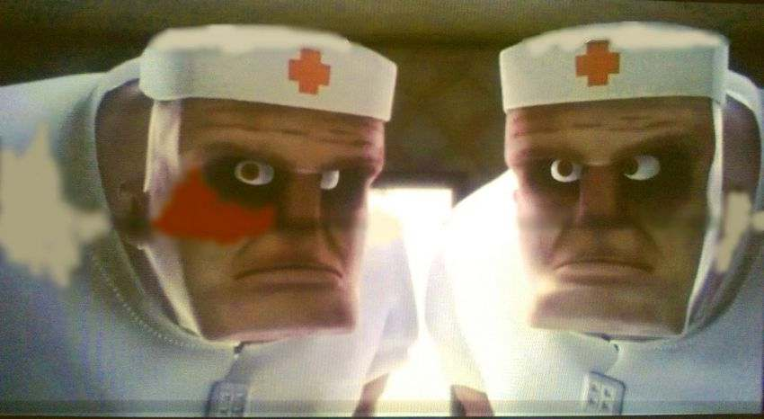
EMO tehnik
Empaatia võimega
Meeskonna liige
Tähelepanelik
Füüsiliselt tugev
https://youtu.be/felVj2vOXGs

