Slide 1

TALLINN HEALTH UNIVERSITY OF APPLIED SCIENCES
2025

Slide 2

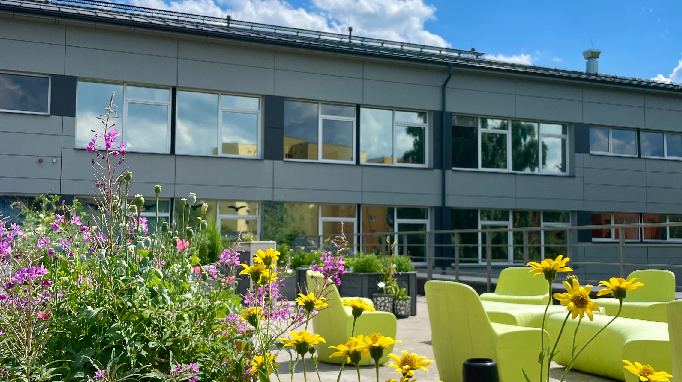
  Internationally recognized state professional higher education institution offering training in the field of health and well-being
  One of the two health care colleges in Estonia
  In addition to Tallinn and Kohtla-Järve, studies are also conducted in other regional units
  Rector since 2001 - Ms Ülle Ernits
  As of 2025, the university has more than 2,300 students and 200 employees
Tallinn Health University of Applied Sciences

Slide 3
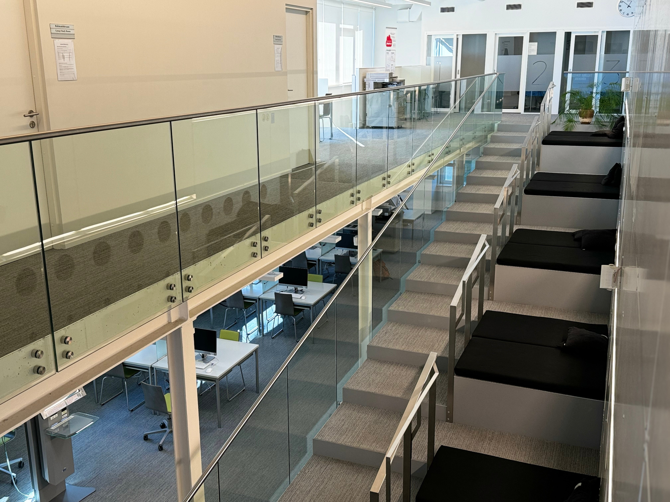
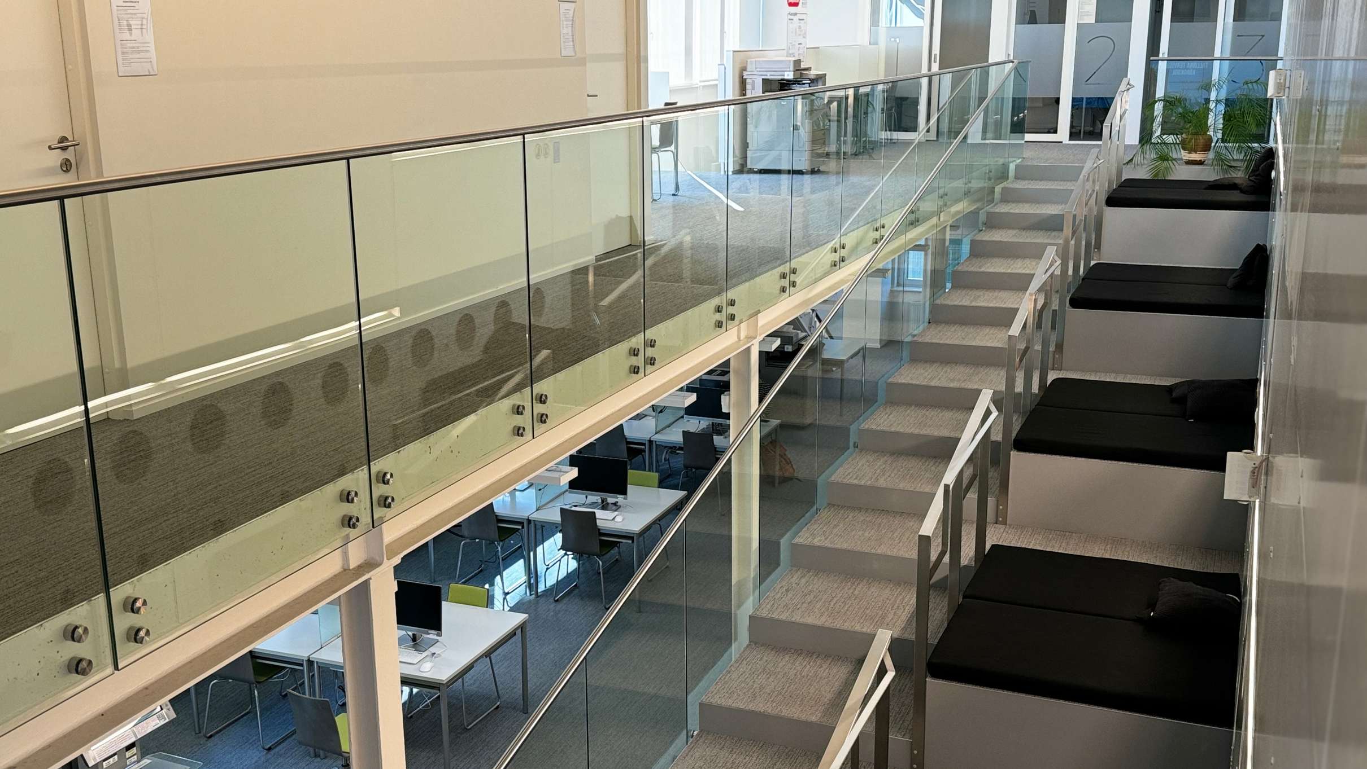
  Mission
  The College trains innovatively and critically thinking health professionals with technological competences.
  Vision
The College is in continuous development, nationally and internationally networked organisation, where, in collaboration with national and international partners and involving the learners, current challenges are addressed.
Mission, Vision and
Core Values
  Core values - IKKA (Inimene, Koostöö, Kaasamine, Areng)
People - Cooperation - Inclusion - Development
Our core value is the human being. We cultivate collaborative skills in our students, involve our employees, students, alumni, and partners in leadership and development activities, and base our actions on innovation and progress.

Slide 4

Tallinn Medical School became a higher education institution and was renamed Tallinn Health Care College
Tallinn Medical School
was founded
2002
1940
Nursing education studies
(for nurses with previous vocational education)
started in Kohtla-Järve Medical School
2005
Kohtla-Järve Medical School
became a structural unit of
Tallinn Health Care College ​
Important Dates
2006
First admission to College’s
Health Sciences Master’s Program ​
2019
2007
The first nursing study
group was opened at
Kuressaare Hospital.
2018
Studies started in
Pärnu Hospital
The first nursing study group was opened in Haapsalu.
2023
The first nursing study group was opened in Rakvere.
2025
October 16 anniversary of Tallinn Health University of Applied Sciences
2024
The name in English changed to: Tallinn Health University of Applied Sciences

Slide 5
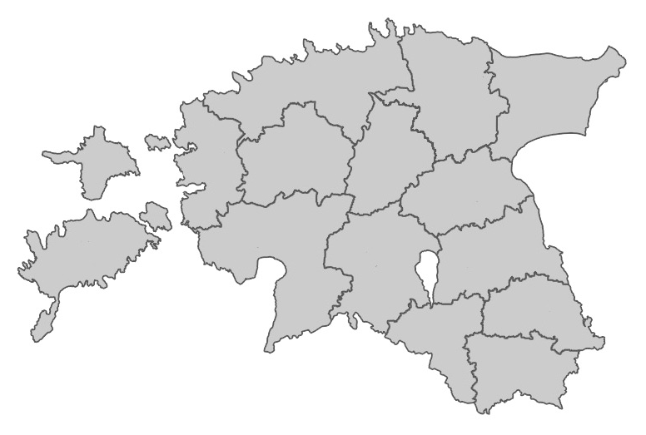


Tallinn
Rakvere
Kohtla-Järve
Regional Studies
Haapsalu
In addition to applied higher education, we also provide vocational training in other
regions of Estonia.
Pärnu
Kuressaare

Slide 6
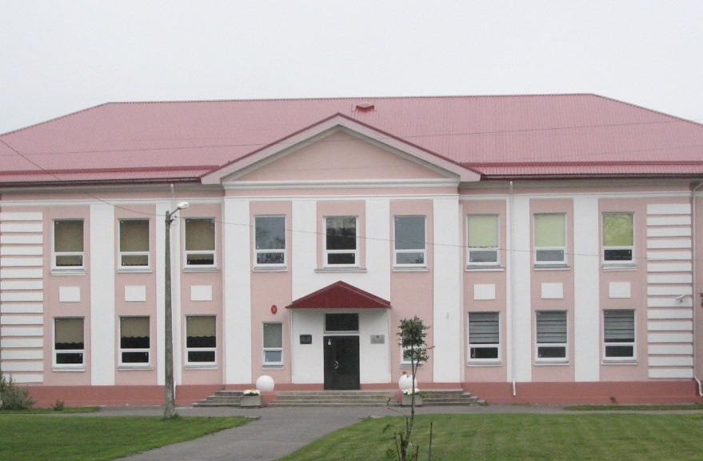
  2002 – Nursing education studies (for nurses with previous vocational education) started in Kohtla-Järve Medical School
  2006 – Kohtla-Järve Medical School became a structural unit of Tallinn Health Care College ​
Structural Unit in Kohtla-Järve
  Programmes taught in Kohtla-Järve:
  - Nurse
- Care Worker
  - Health Promotion

Slide 7
Advisory Board
College Council
Structure
Administrative Structural Units
Lifelong-Learning
Center
  Medical Technology Education Centre
  Health Education Centre
  Chair of nursing
  Vocational Education Department
Student Council
Rectorate
Rectorate Office
IT Services
Study Department
Consulting Board
Partners
Stakeholders

Slide 8
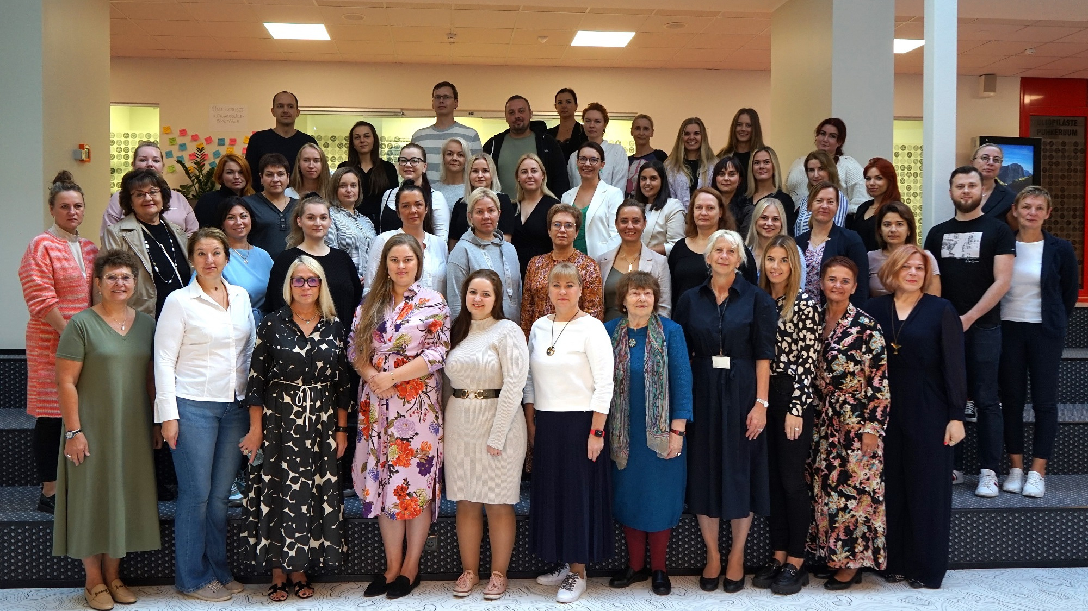
Health Sciences Master’s Degree:
  clinical nursing
  public health nursing
  intensive care nursing
  mental health nursing
Nominal length of study: 1,5 years
Master's programme

Slide 9
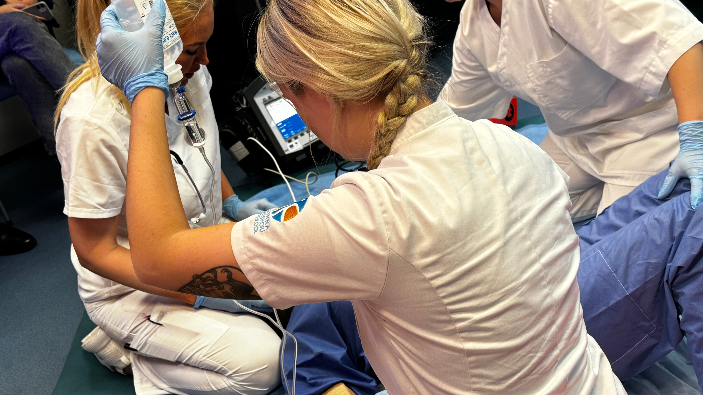
  General Nurse – 3,5 years
  Midwife – 4,5 years
  Optometrist – 3,5 years
  Pharmacist – 3 years
  Dental Technician – 3,5 years
  Occupational Therapist – 4 years
  Health Promotion – 3 years
Programmes of Higher Education​

Slide 10
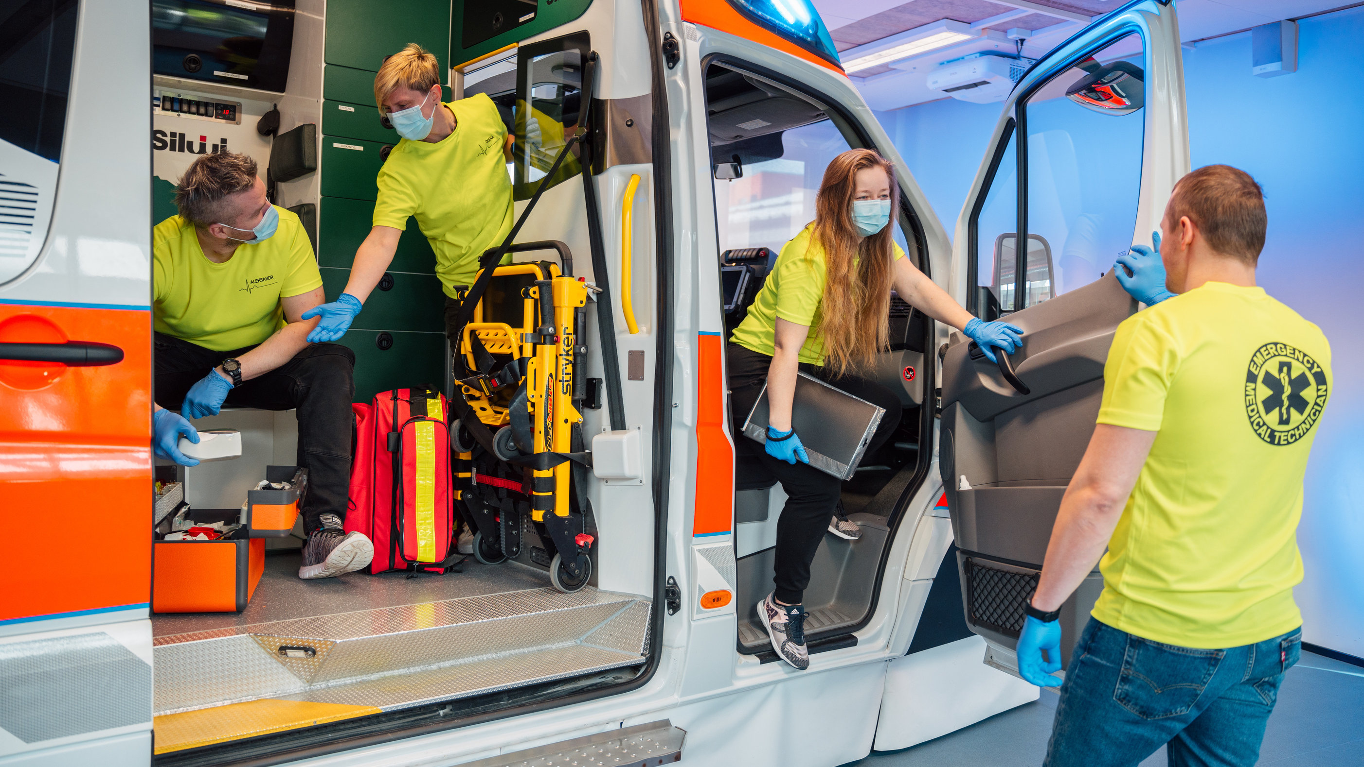
  Care Worker – 2 years
  Emergency Medical Technician – 1 year
  Childminder – 1 year
  Client Worker for People with
Mental Health Problems – 1 year
  Dental Assistant– 1 year
  Sterilisation Techinician- 1 year
  Clinical Secretary- 1 year
  Assistive technology specialist - 1 year
Programmes of Vocational Education​

Slide 11
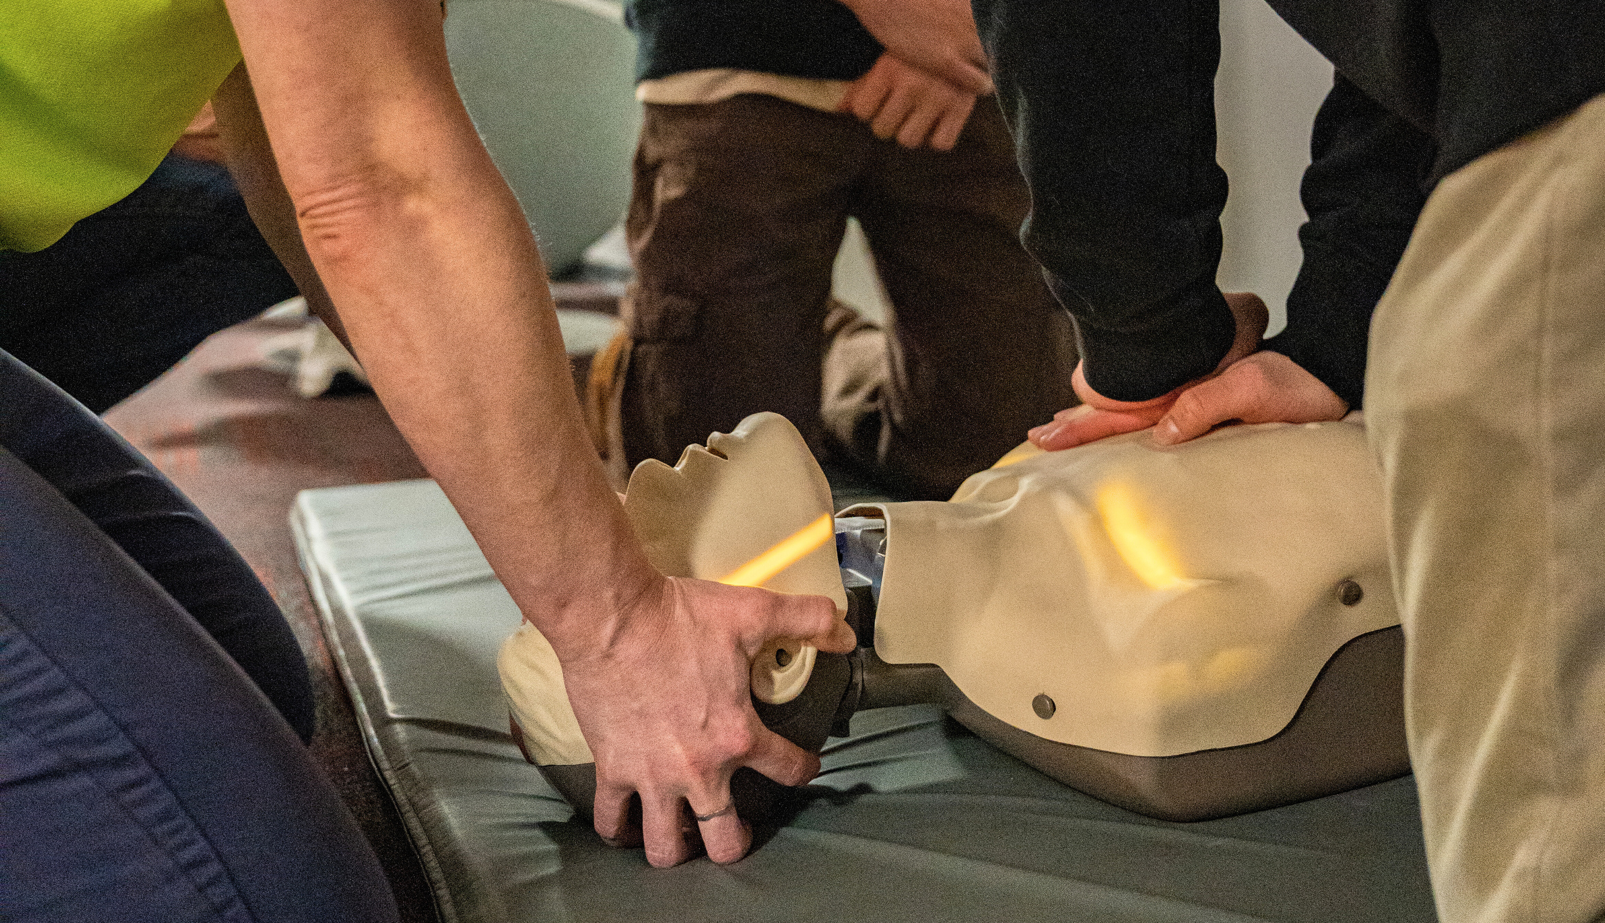



We organize continuing education courses in the fields of social services, healthcare, and well-being, supporting the development and retraining of professional knowledge and skills. We offer commissioned, national, and project-based trainings as well as open enrollment courses.
In 2024
In 2023
Continuing Education
110 trainings
118 trainings
2566 participants
2052 participants
3570 hours
5487 hours
We offer elective courses in the healthcare field also to upper secondary schools.
In 2024, the university had cooperation agreements with 15 general education schools.

Slide 12
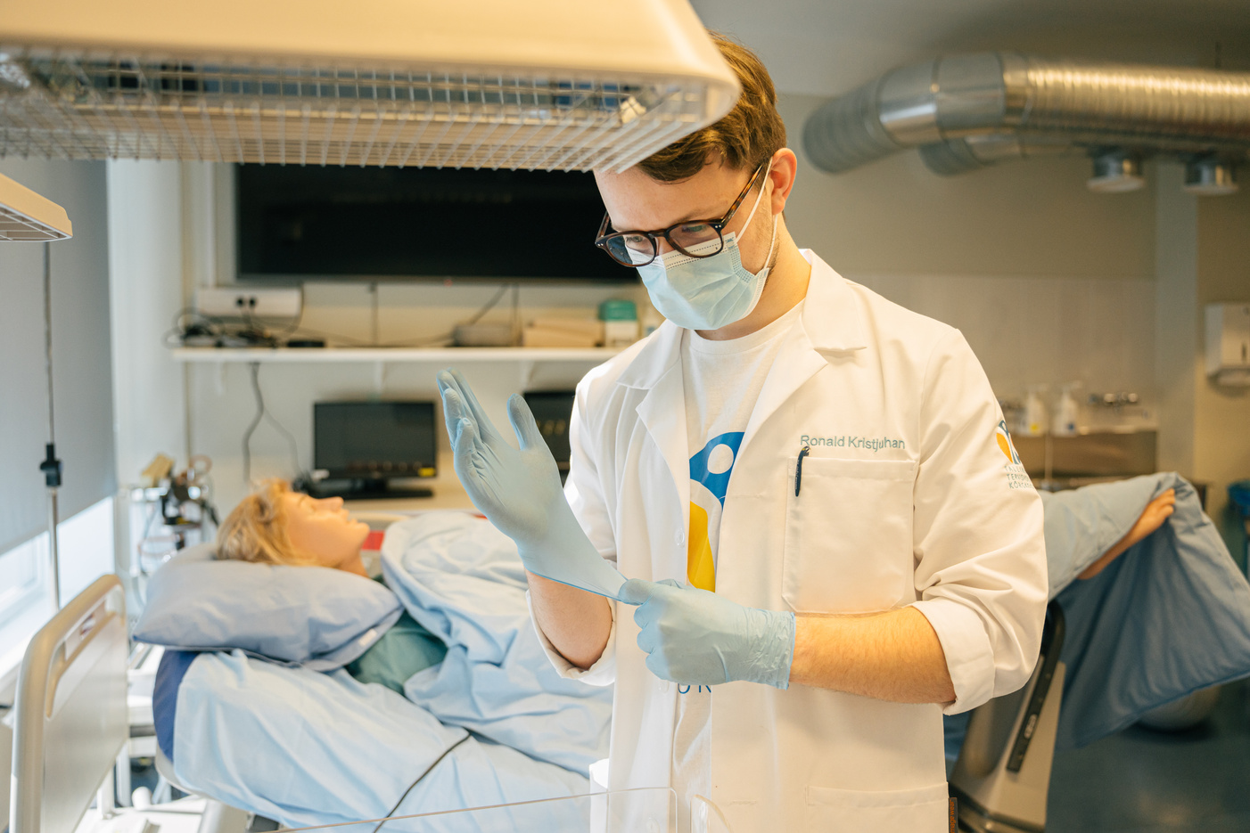
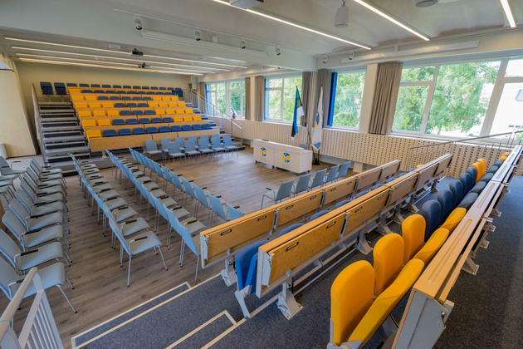
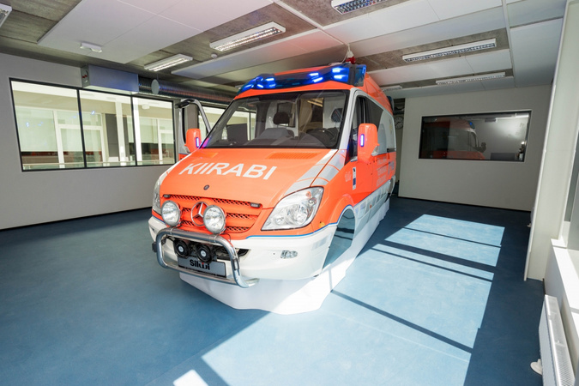

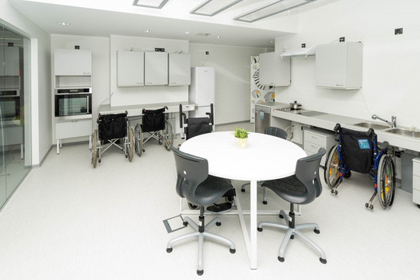
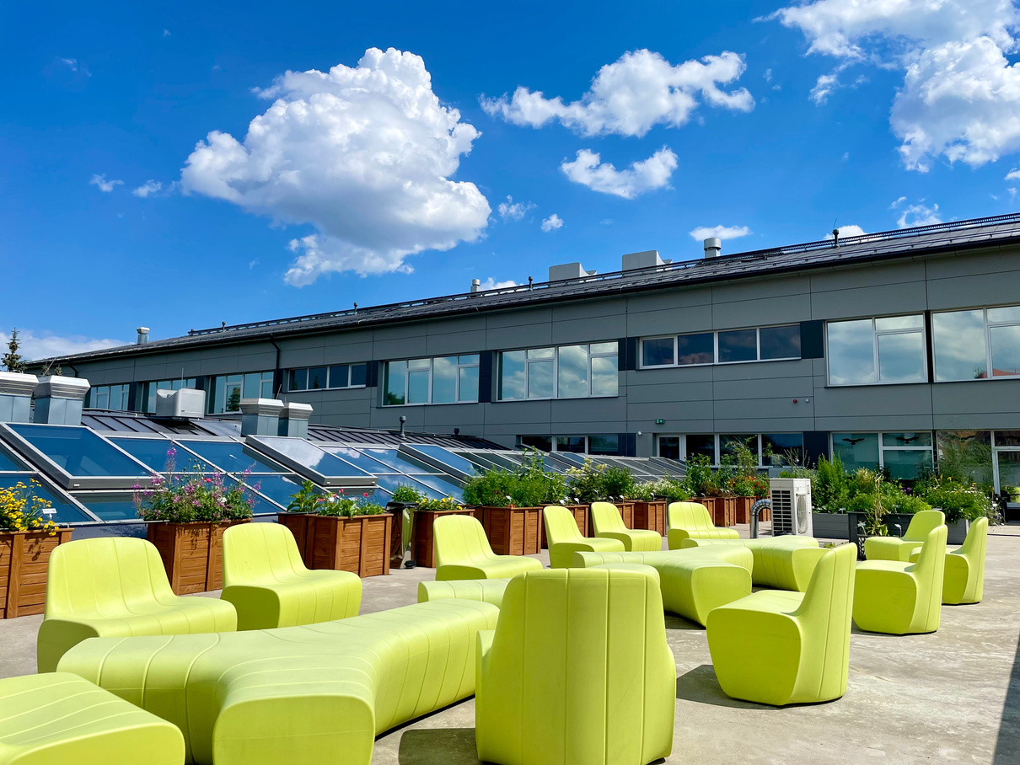
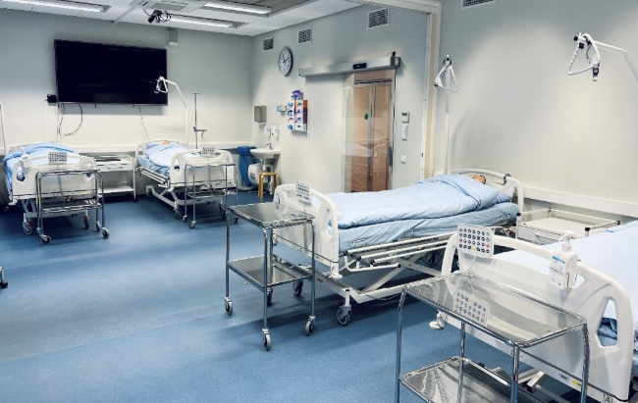
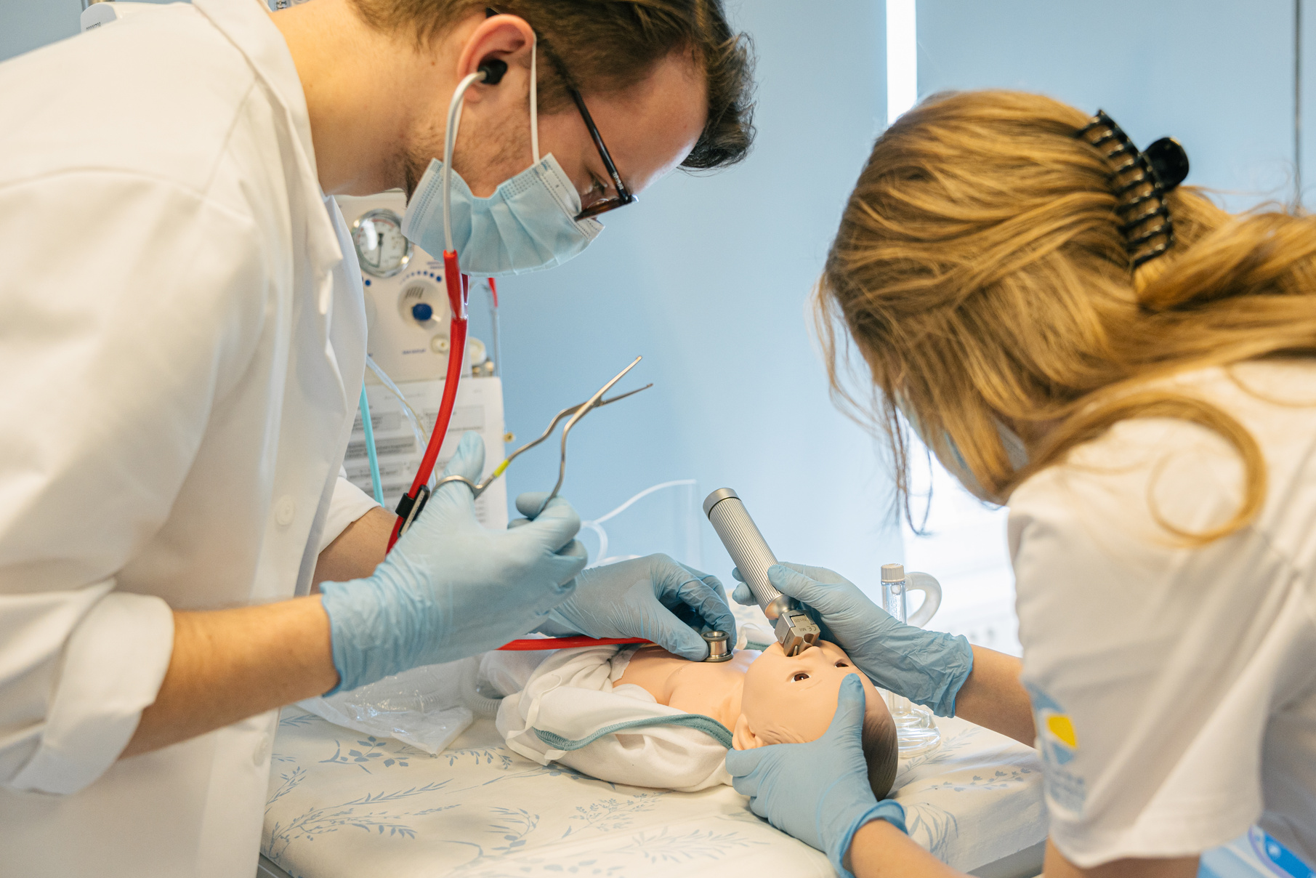
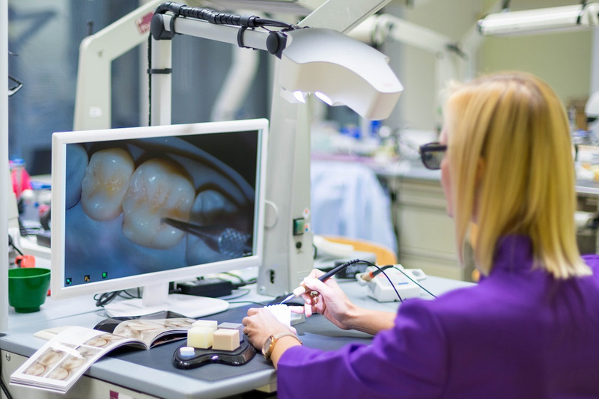
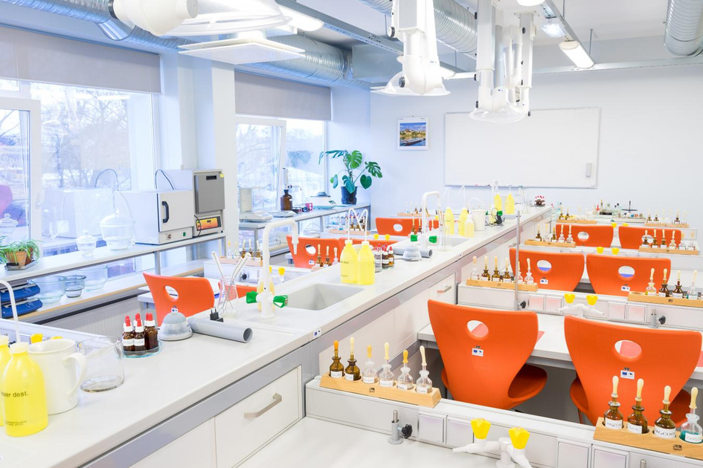
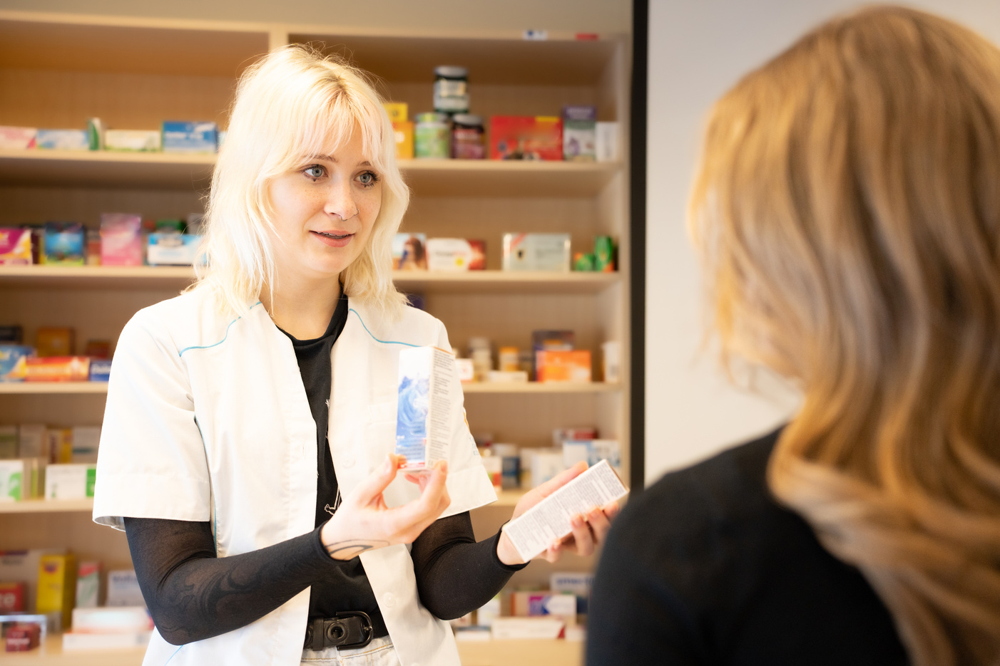
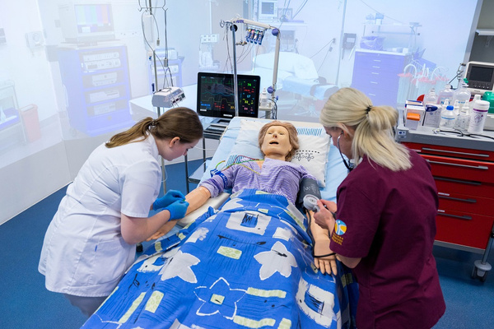
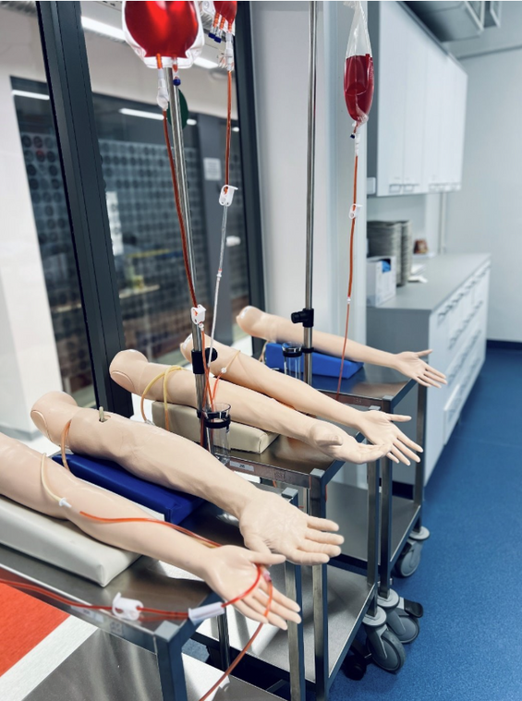
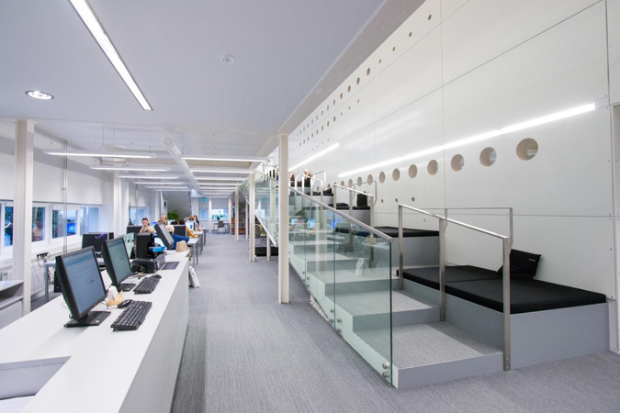
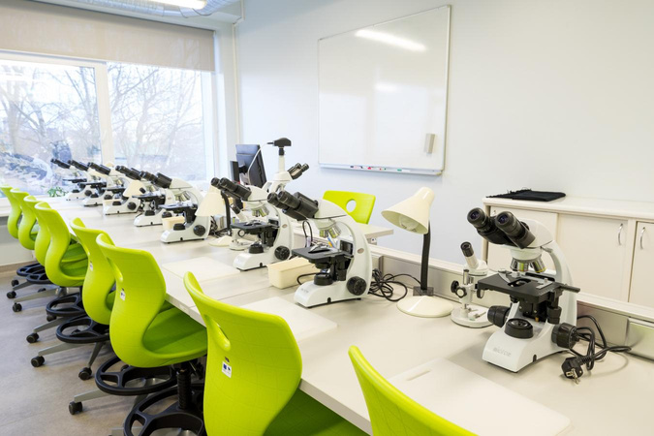
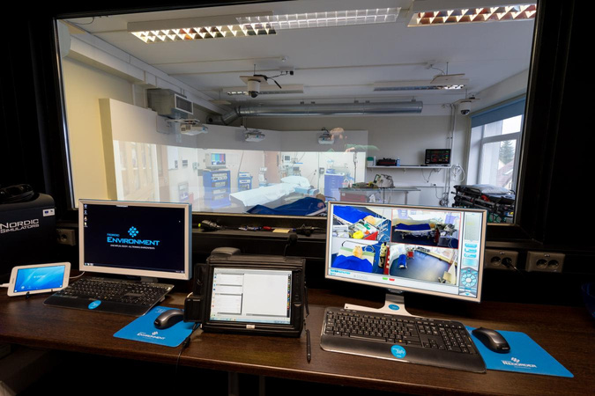
State-of-the-art simulation center and training laboratories. Modern and green environment.

Slide 13




















Praticipation in international organizations​

Slide 14

Main focus areas:
    Promoting health and well-being
    Person-centred healthcare and improving patient experience
    Development, localization, and implementation of professional terminology and tests
    Health humanities: history, development, attitudes, and ethics of nursing
    Development of the healthcare system and health professionals
    Development of curricula and the learning environment
  Our laboratories conduct various measurements, including the assessment of general health indicators, optometric measurements, detection of medicines and other substances, and composition analysis.
  We collaborate with government institutions, hospitals, medical centres, professional associations, universities, and research institutions.
Research and Development

Slide 15
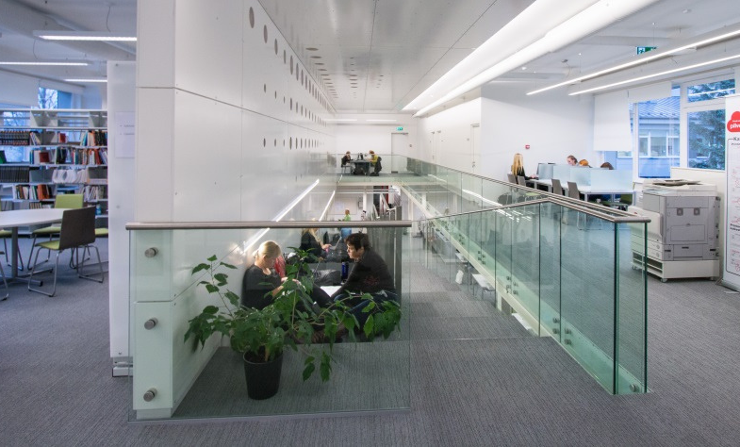
Library
  Tallinn Health Care College has a library both in the college building in Tallinn as well as in Kohtla-Järve structural unit
  Tallinn Health Care College library is a modern innovative study and research environment
  Conducts research and participates in development activities.
  Holdings information is available in the ESTER e-catalogue.
  Scientific databases
  Provides consultations and conducts information sessions.
  Individual rooms, group-work rooms, resting zone

Slide 16
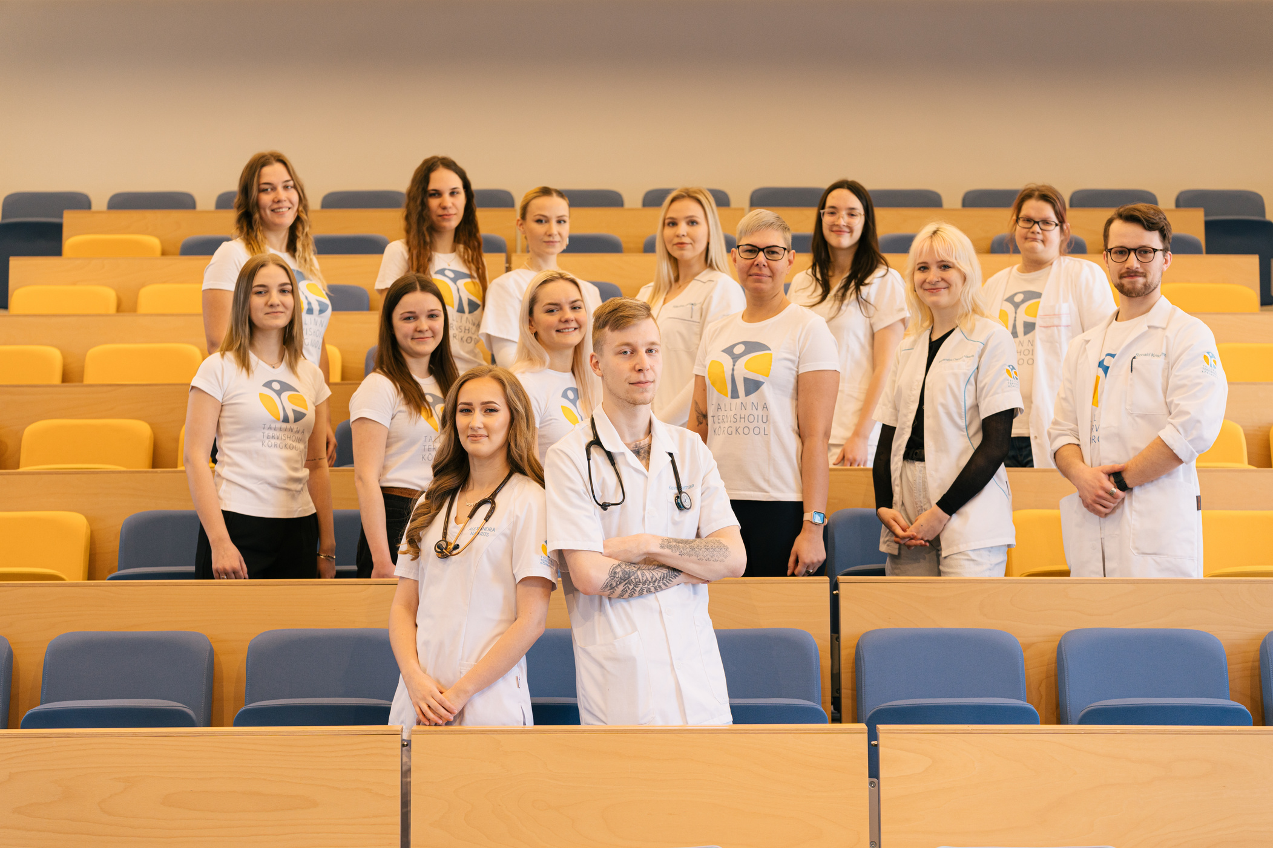
Student Council
  Has been active since 1995

Slide 17
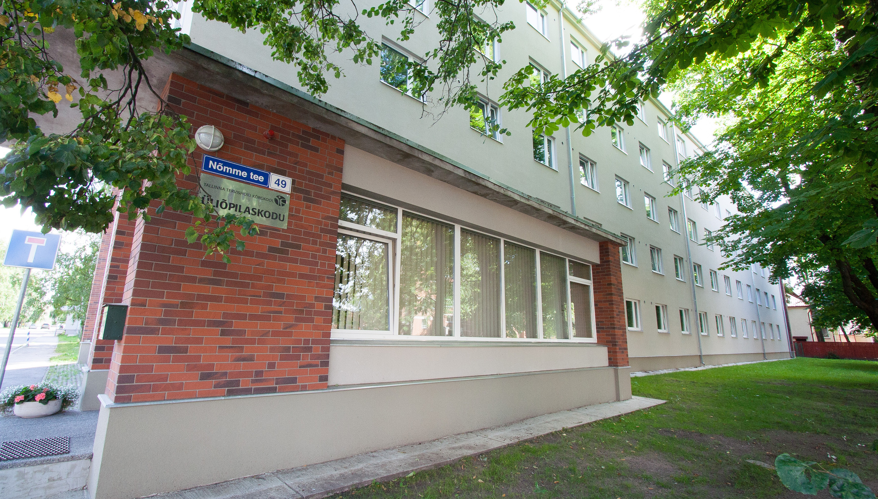
Student Hostel
Location: Nõmme tee 49
Accommodates up to 200 students
Virtual tour:
www.ttk.ee/virtuaaltuur

Slide 18
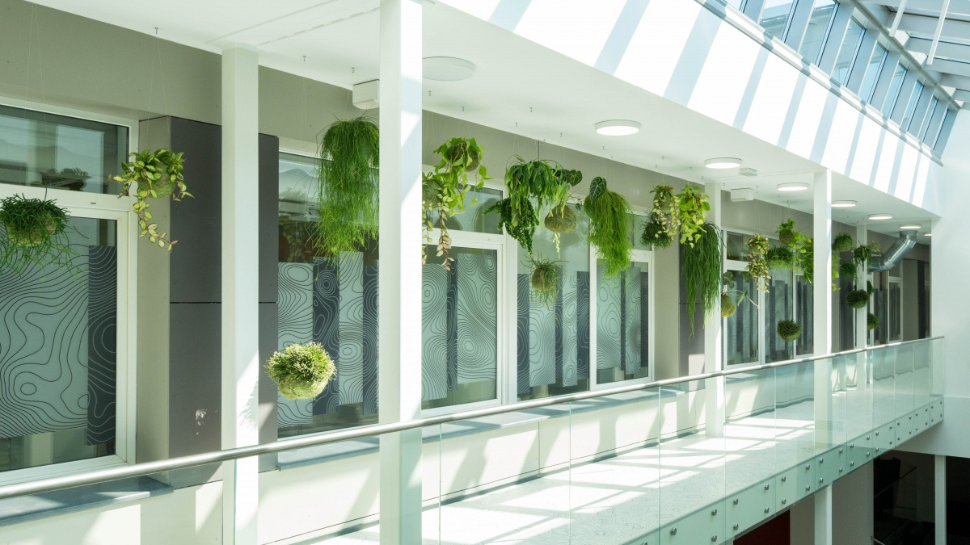



LET'S STAY CONNECTED
Tallinn Health University of Applied Sciences
Kännu 67, 13418 Tallinn
Phone: +372 671 1701
Email: info@ttk.ee
www.ttk.ee
tervisekool
tervise_kool
Tallinna Tervishoiu Kõrgkool

